Slide 1

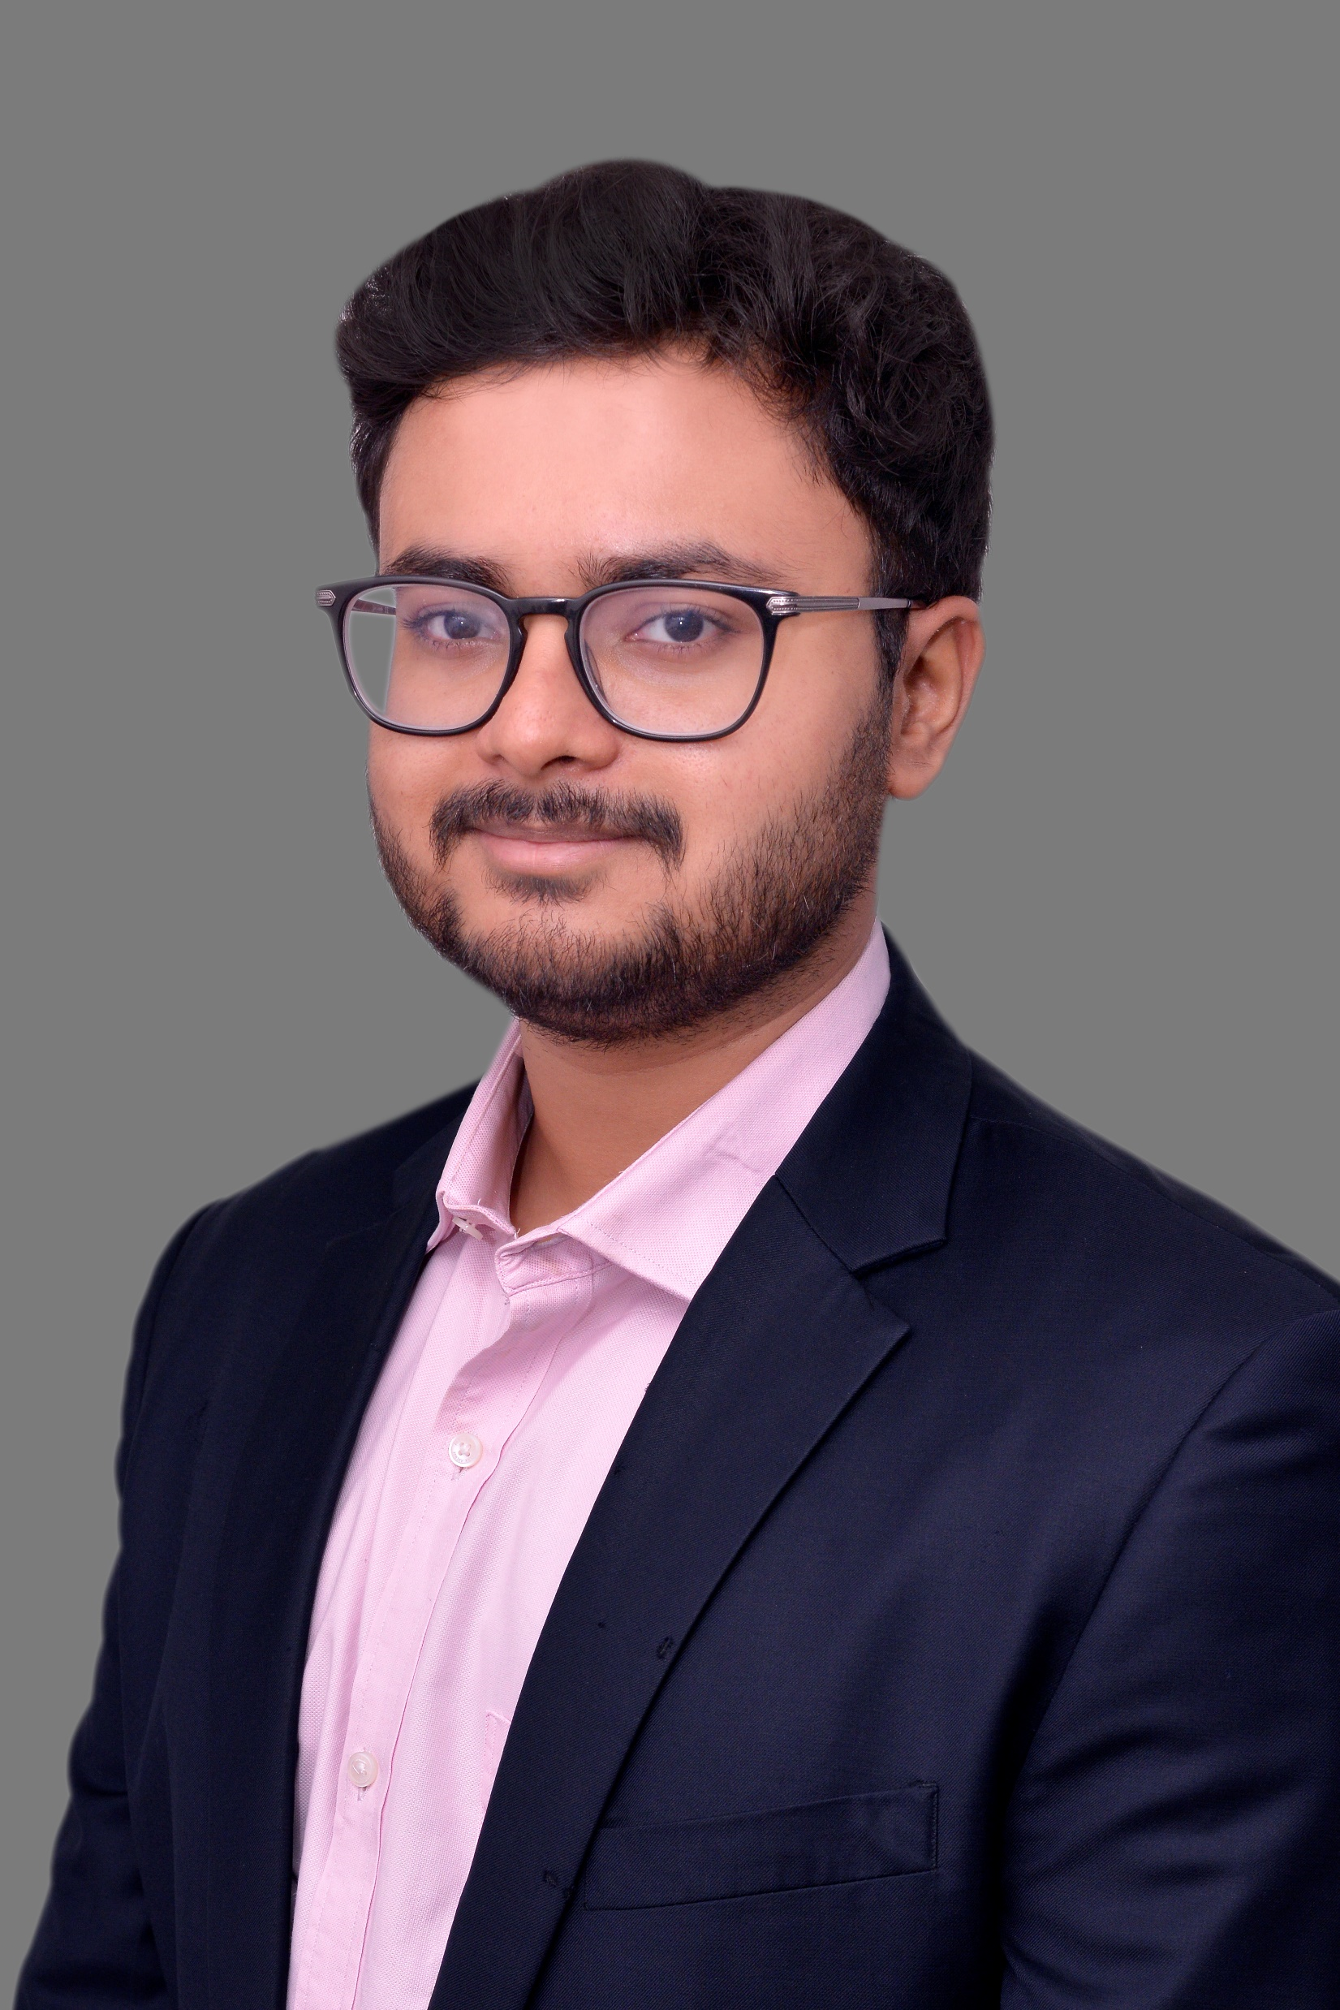
Amal Ray
A consultant with experience in tech and design.

Slide 2
The three worlds
From making films, creating applications and being at the intersection of business and technology at EY, I find myself at a unique position of knowing the three worlds of business, design and technology really well. Using my skills as a storyteller, I create narratives through my designs, taking the users on a walk through the app and making accessibility a priority.

Slide 3
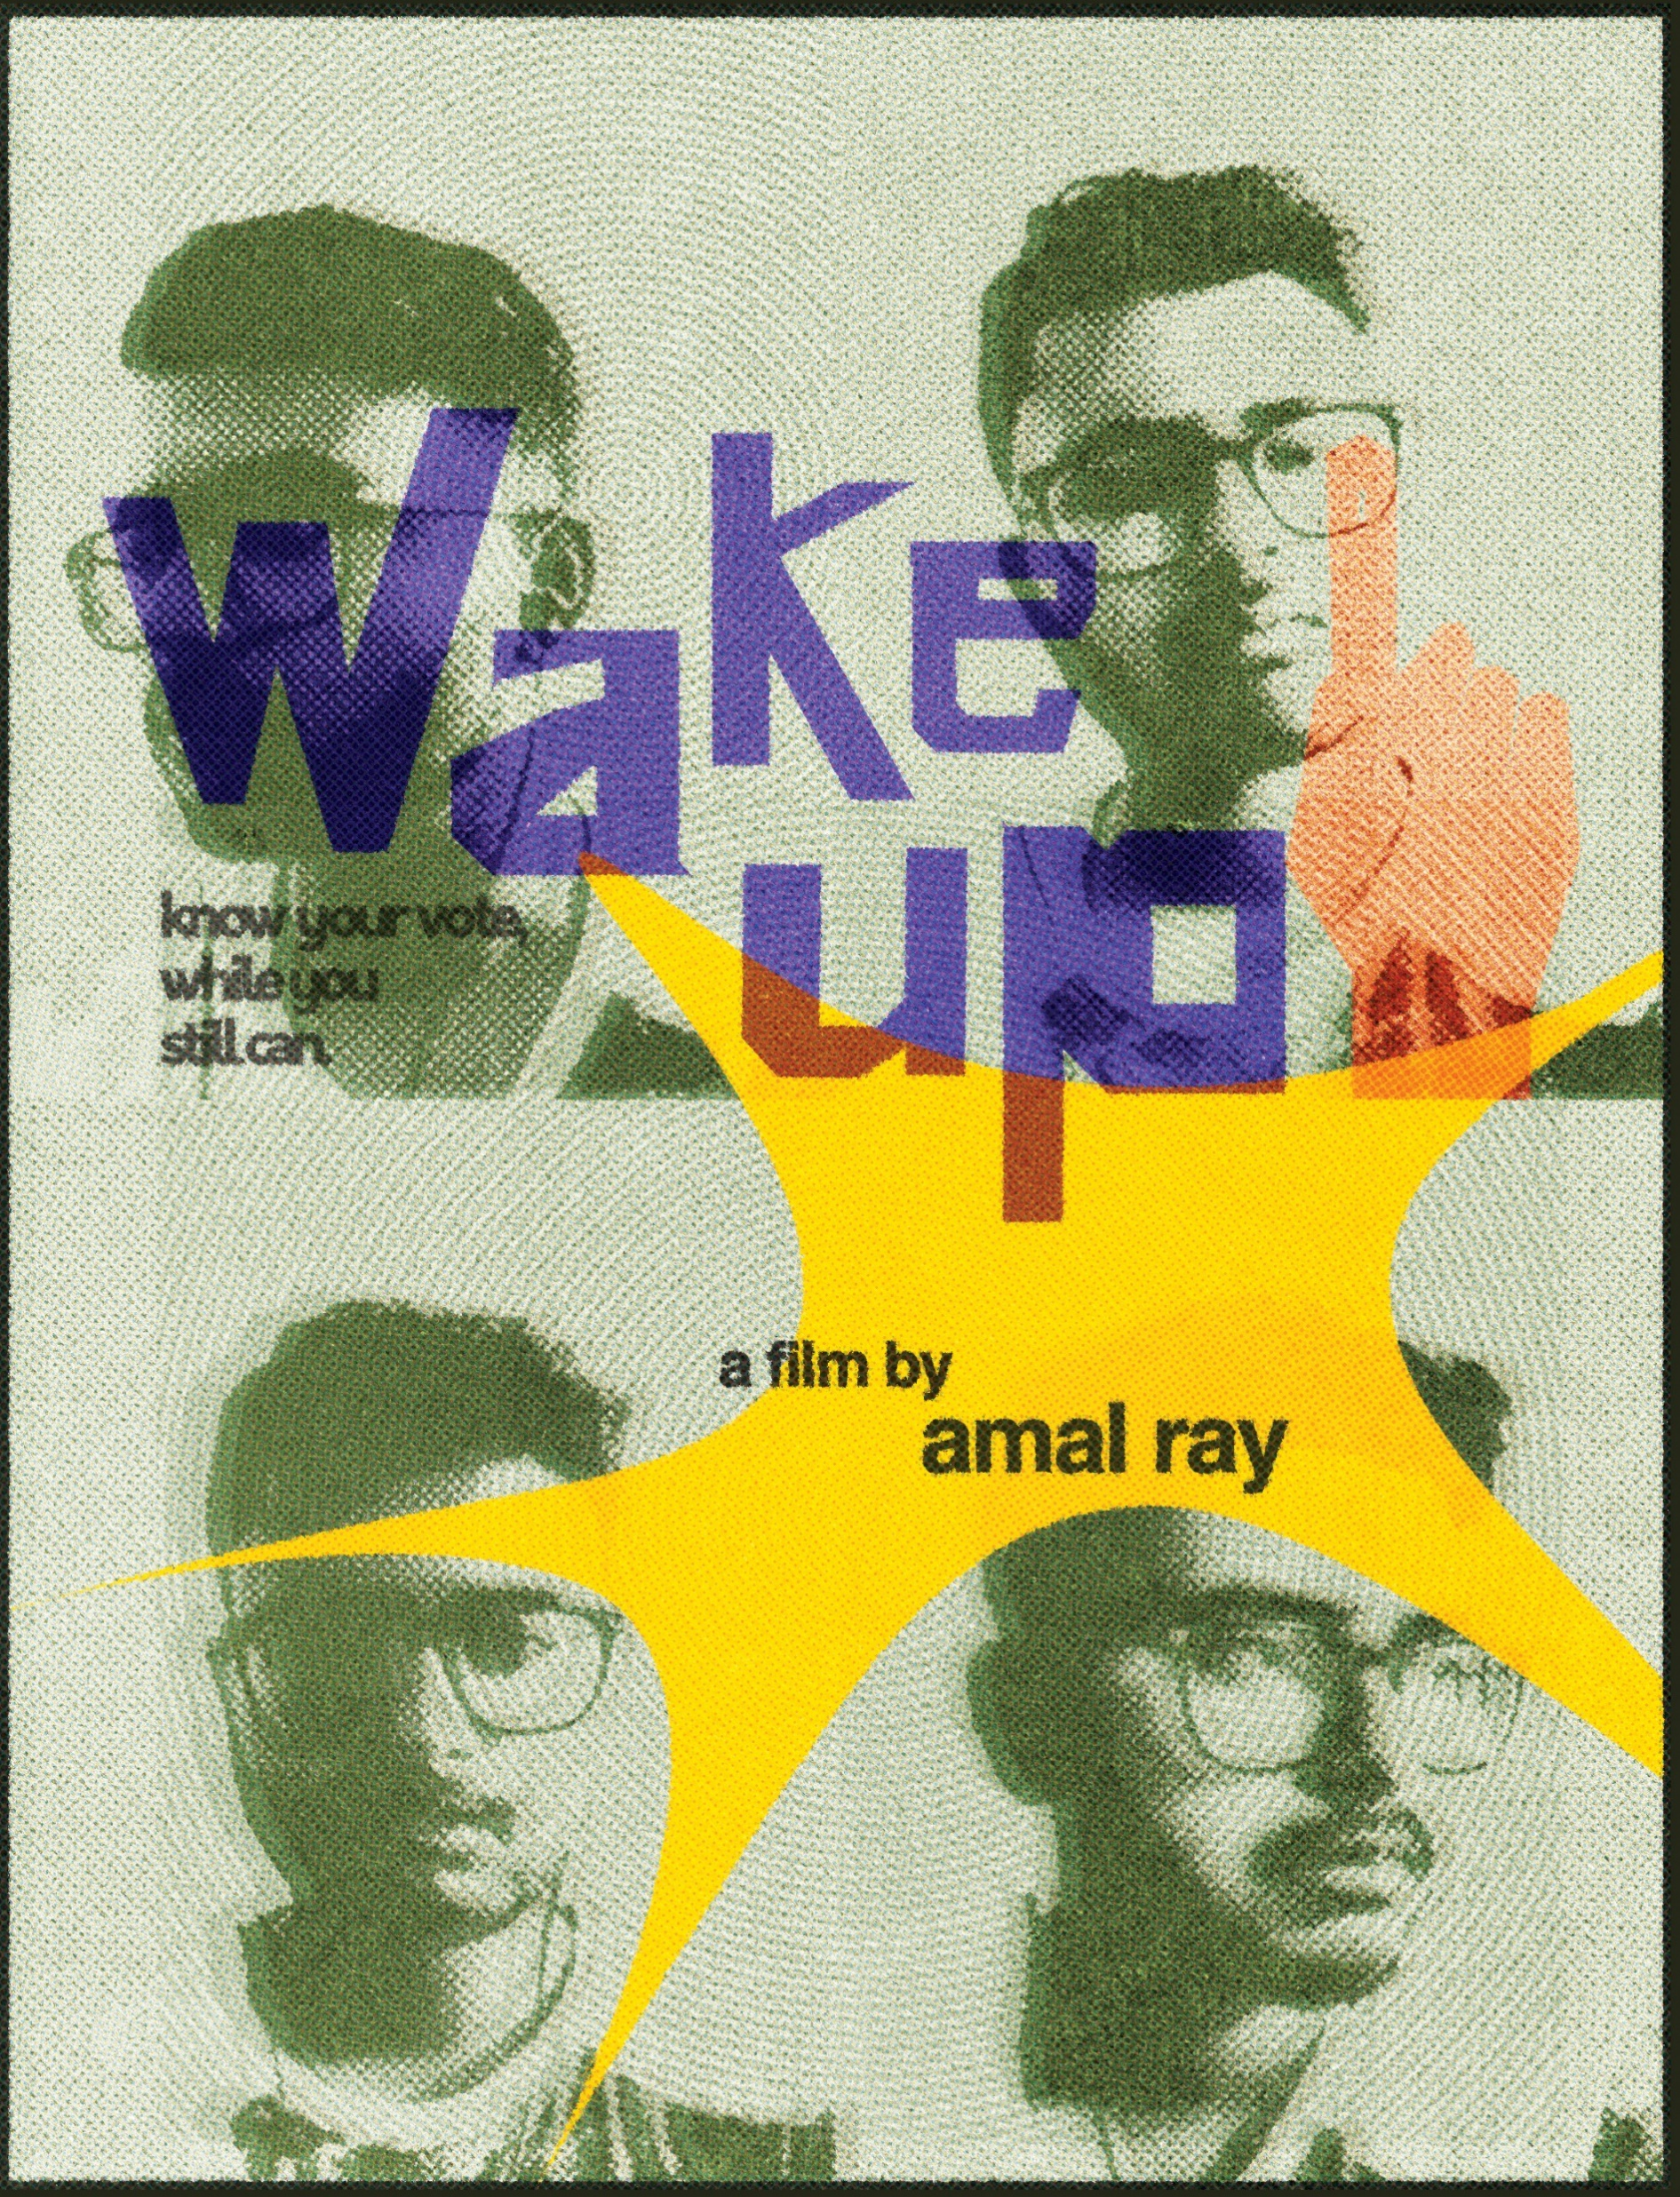
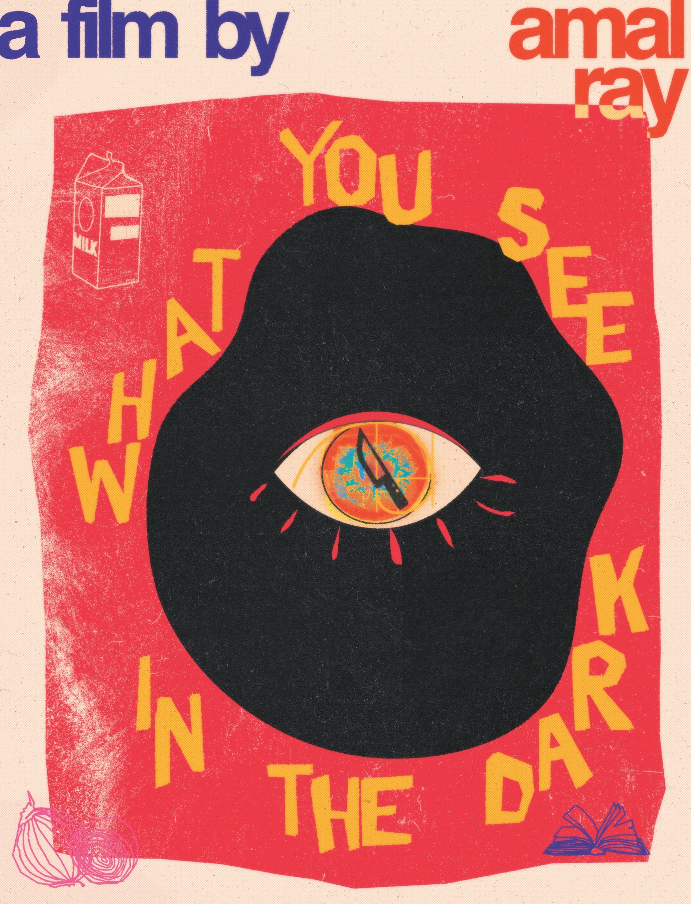
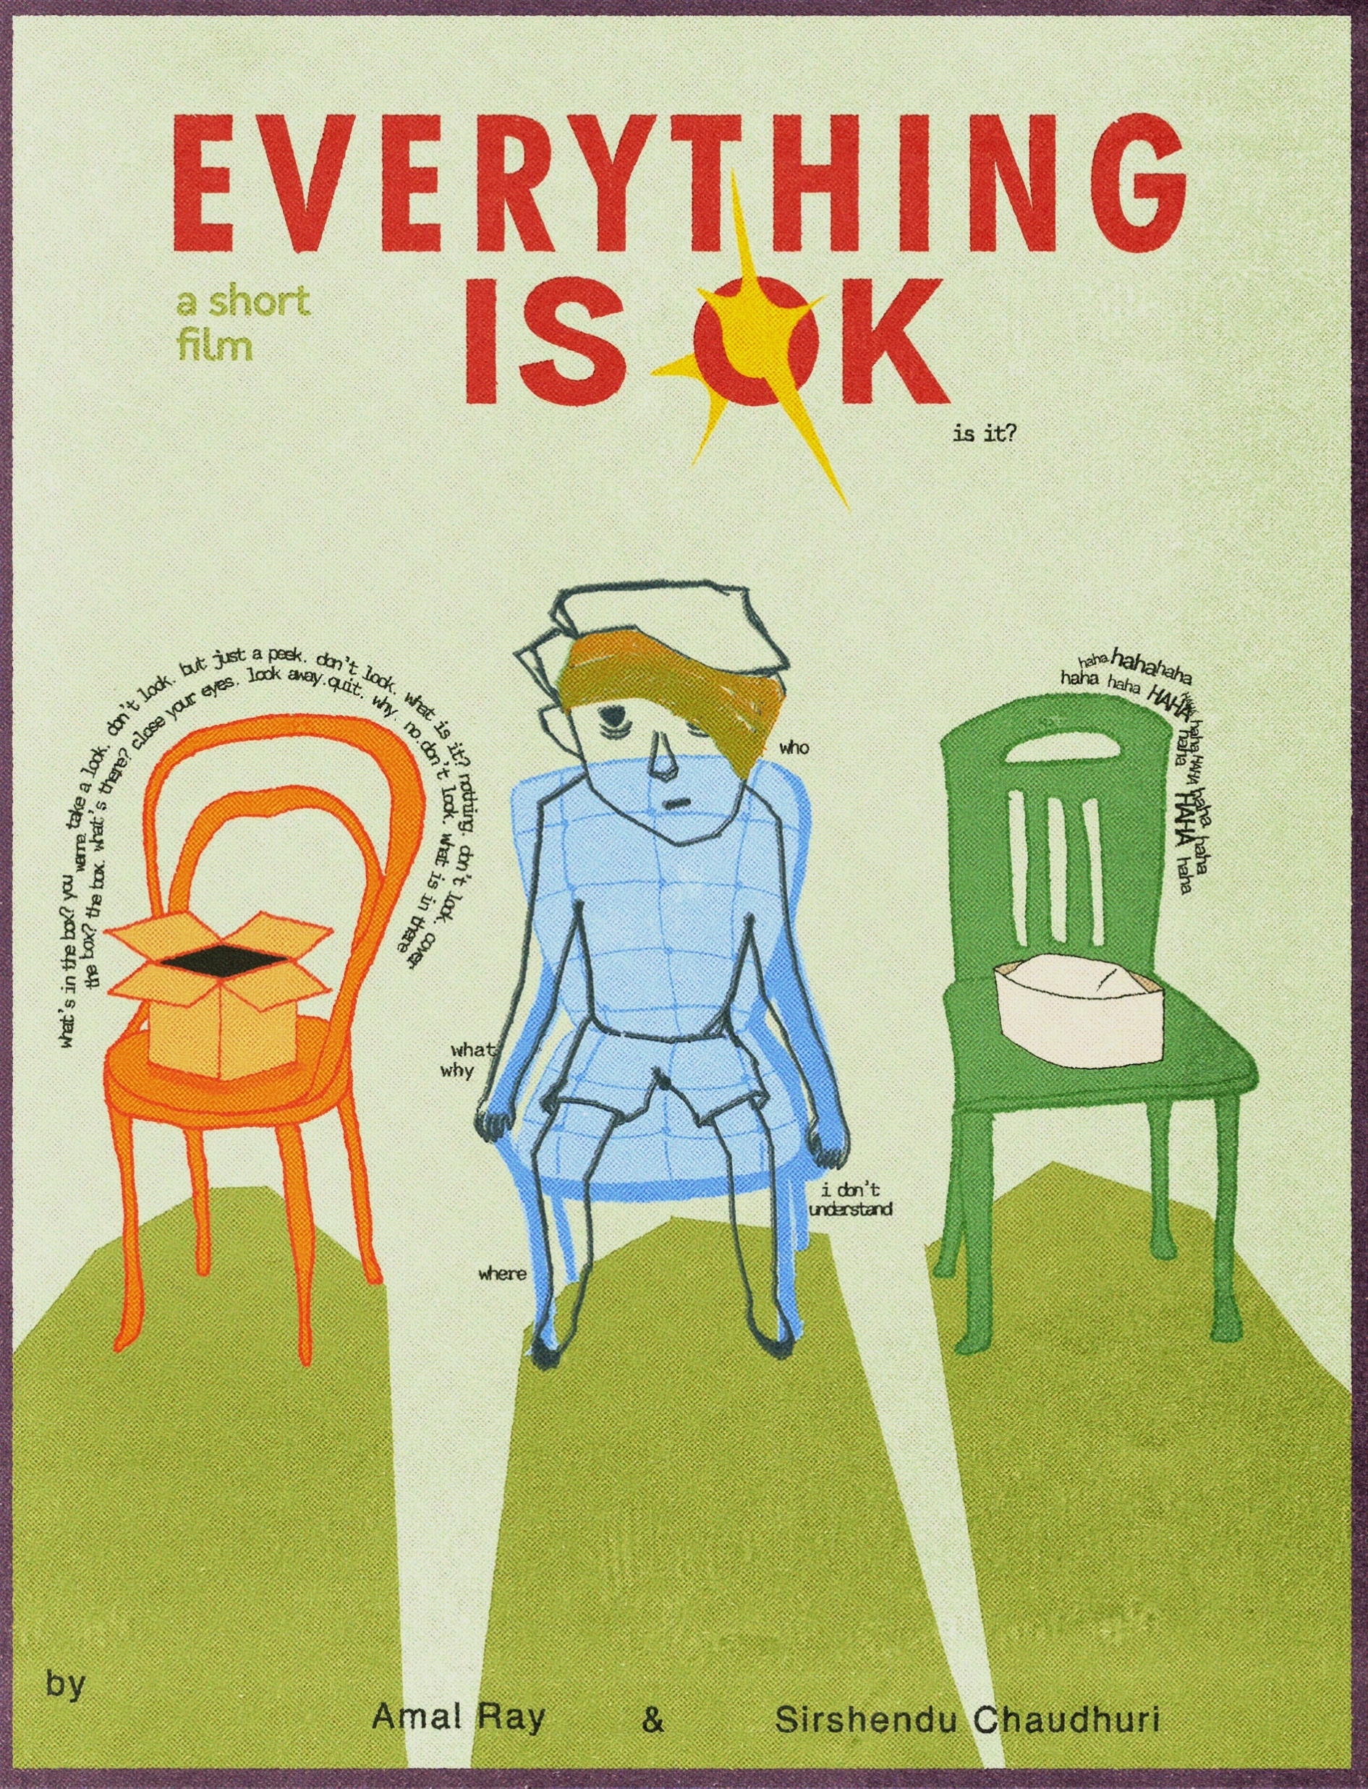
College and Passion
Filmmaking was my first foray into design. This experience has shaped most of my thinking when it comes to tech creation. Be it passion projects like films or business applications, storytelling is a primary feature of any thing which someone creates, and others perceive. All my films were made during quarantine when the world was stuck in their homes during the pandemic. They were edited using Premiere Pro.

Slide 4
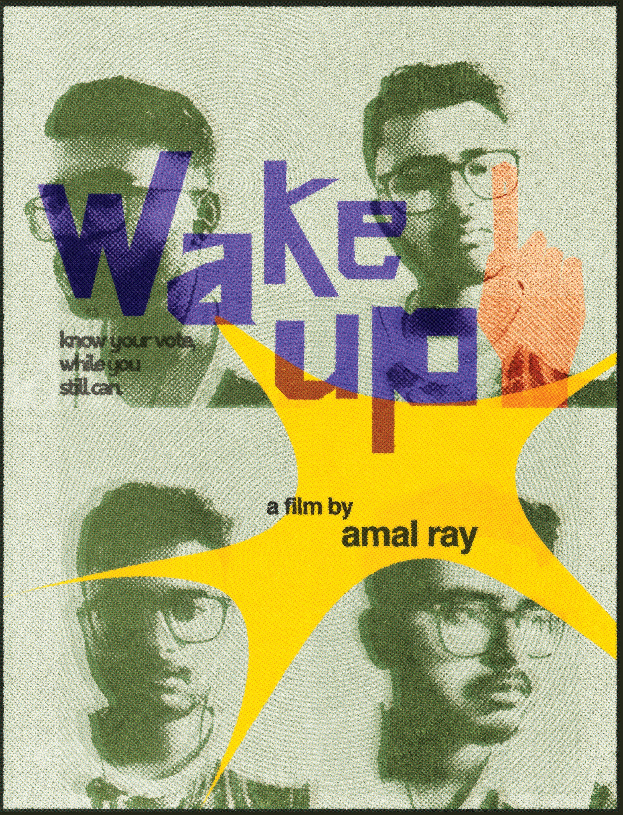
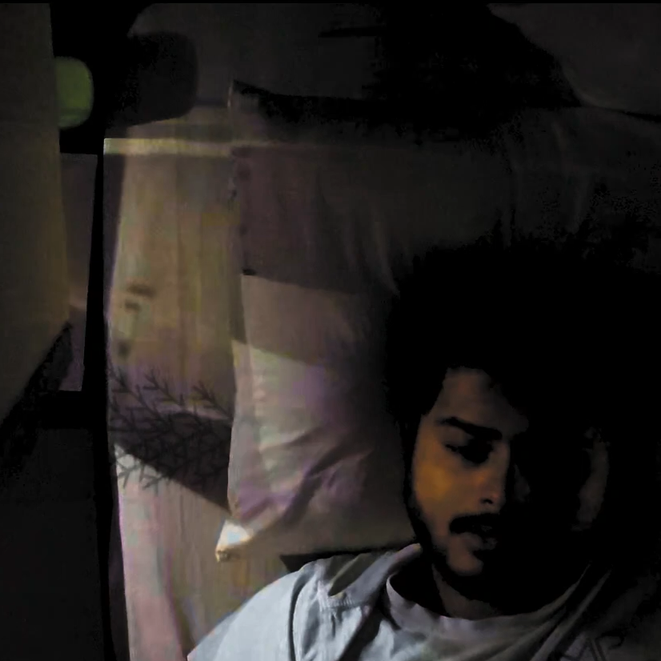
Wake up
After learning editing on Premiere Pro and creating edits of my favourite moments in pop culture phenomenon like Star Wars, The Office and Brooklyn Nine-Nine, I set out to make my first film about voting. What started as an experiment blossomed into an interesting film which made me realise how much is possible within your own room. Everything from the story, direction and editing was done by me.

Slide 5
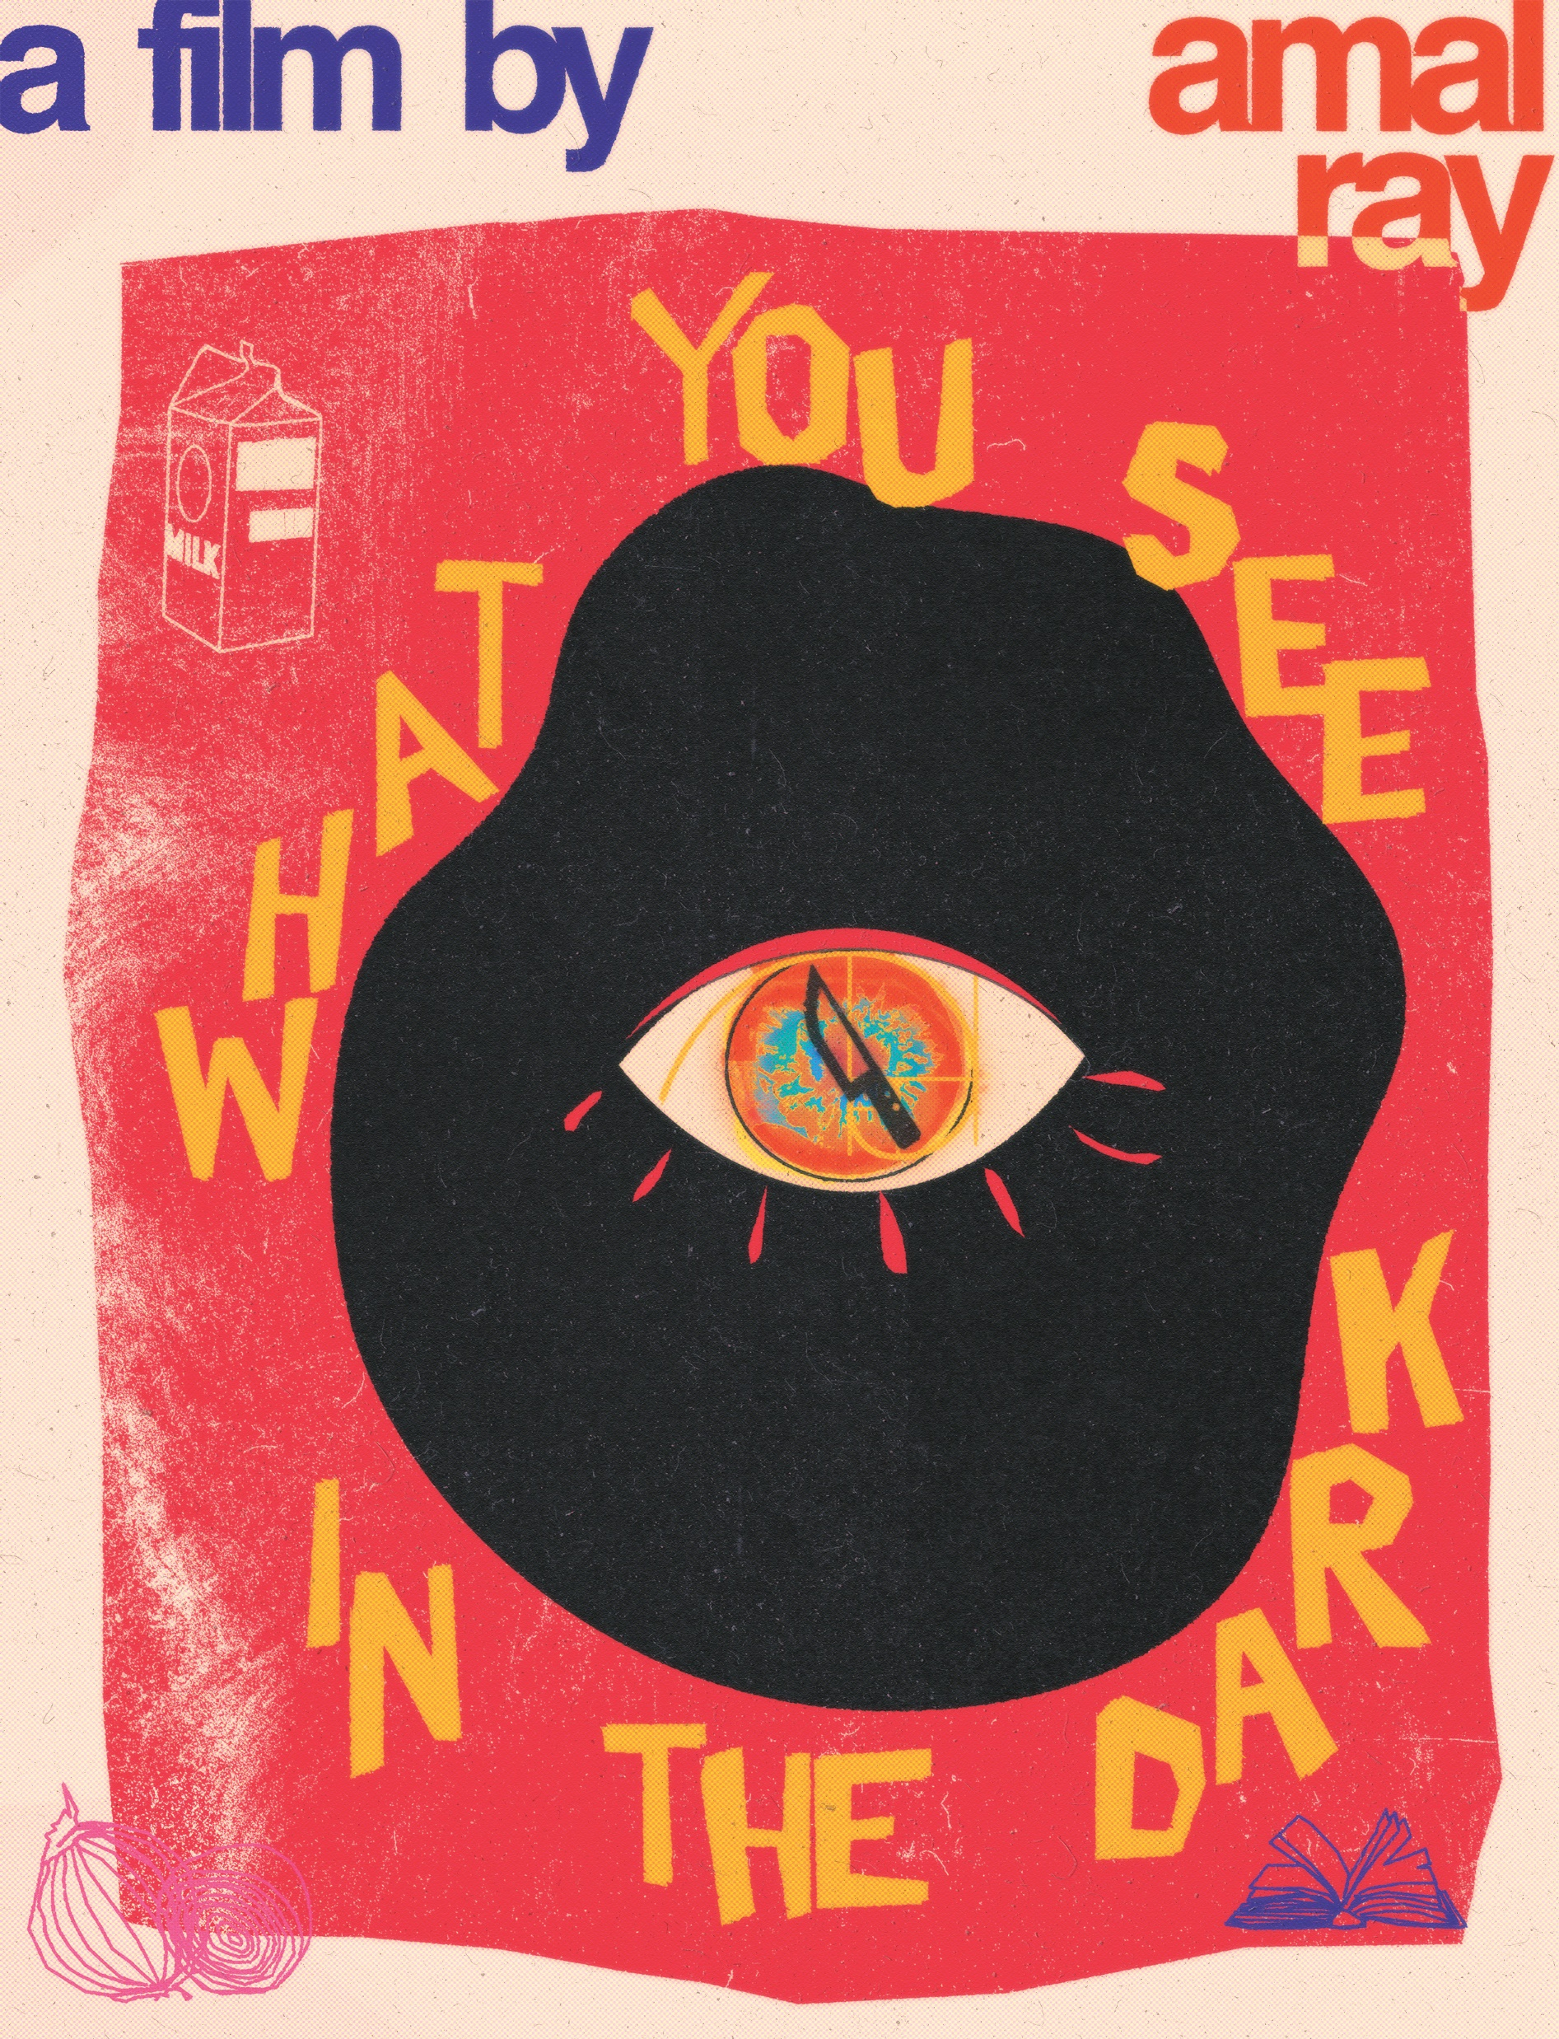
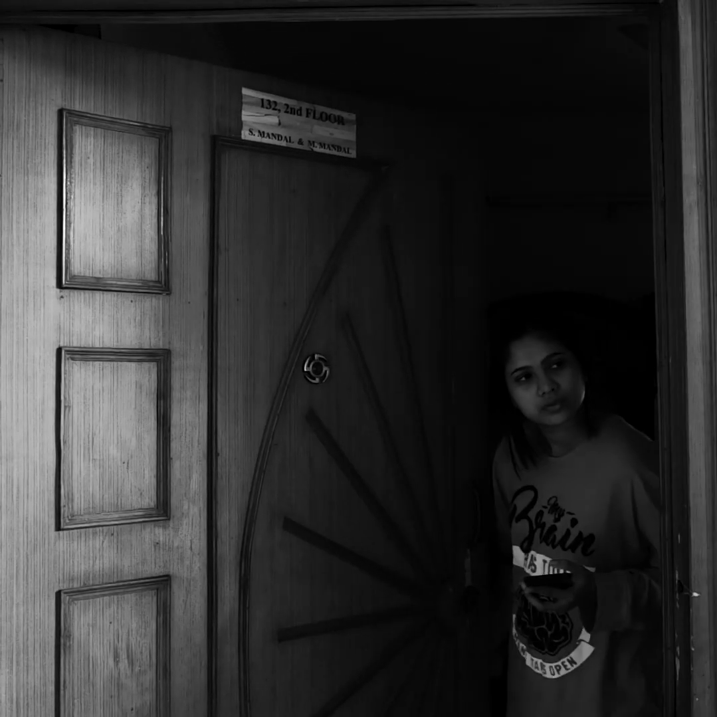
What You See in the Dark
After my first film, I set out to direct a film in collaboration with other people. Again, this was during the pandemic. Shot across India and weaved into a murder mystery, this story spans multiple genres – something which I wanted to try for a long time. This film was written, directed and edited by me. The experience of creating this in the editing room shaped so much of my working style. I could set the tone, the create narratives and fill in the missing parts with reshoots – one of the most fun experiences of my life. We won Best Cinematography and Best Film (3rd) at the VIT Film Festival, and were also nominated for international film festivals (Kalakari International Film Festival, Liftoff Online Pinewood).

Slide 6
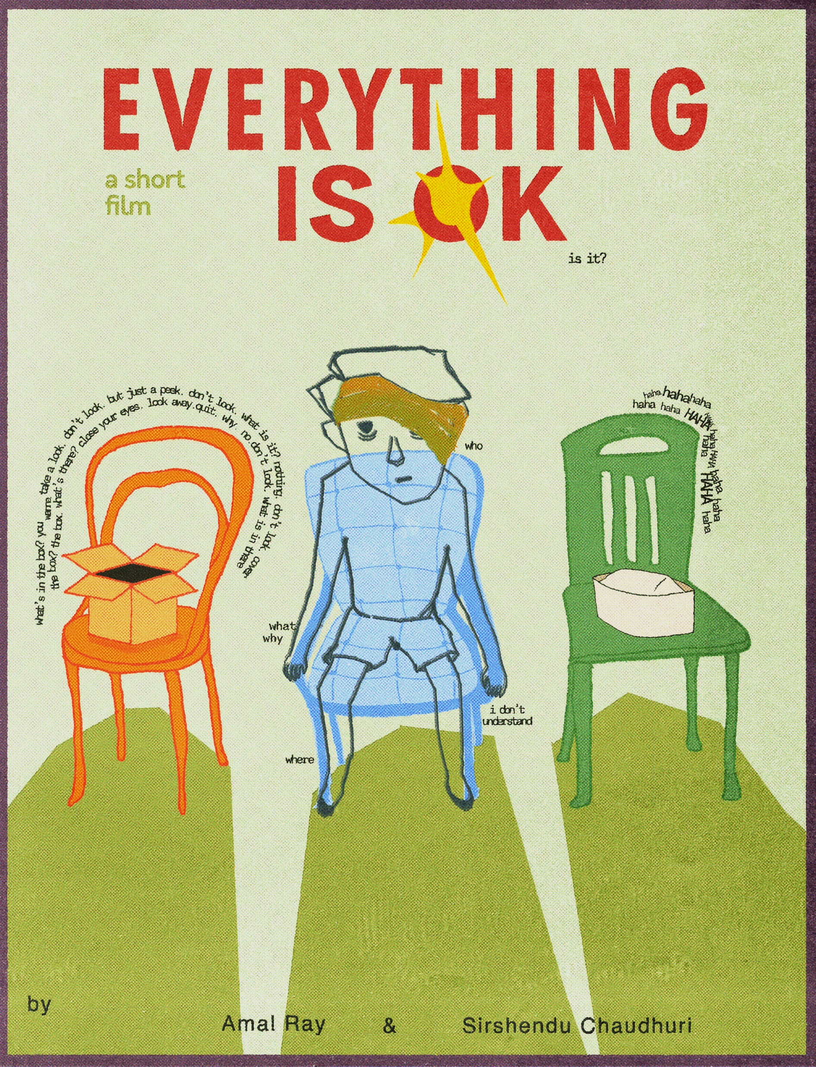
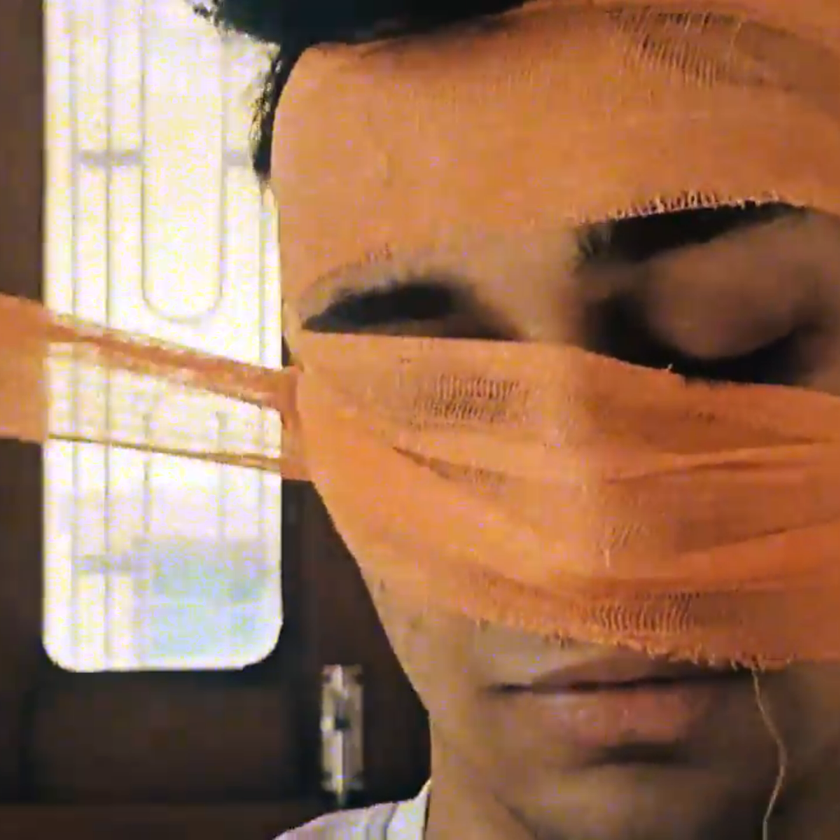
Everything is ok
The most experimental film of the lot, Everything is Ok doesn’t even have a title card, aiming to tell a story with as little context as possible, but entirely through the medium of cinema. Through this film, I wanted to explore the ruling party’s control on the nation’s media and what can and can’t be seen by citizens, through the lens of a broken and battered personification of the country.

Slide 7
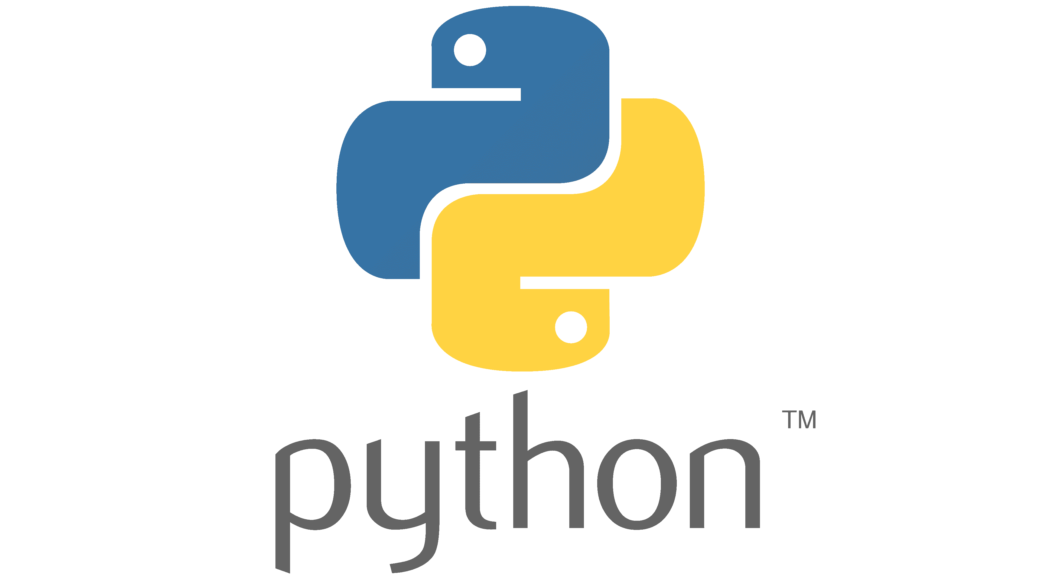

Risk, Compliance and Applications
At work, having had interest and experience in python and java, I had to be flexible enough to switch to use a low-code application platform like PowerApps. PowerApps was used in a project for certain business process for ease of integration. However, it also allowed me to think beyond the code and focus more on the usability of a product. The following examples have changed names and tentative designs because of the proprietary nature of the projects.

Slide 8

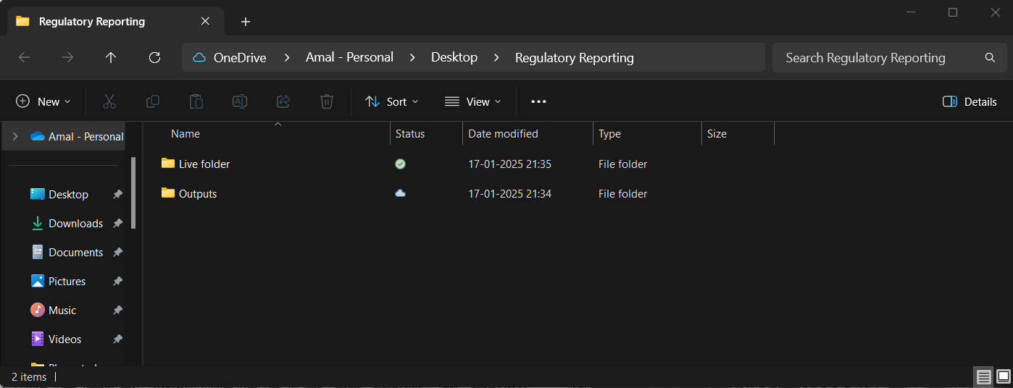
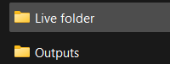
Python Automations
My first tech design at work – that too interestingly without my knowledge – came as a drive to make an arduous data checking project a bit more interesting and easier. Tasked with doing the same data checks everyday, partly manual and some parts automated, I wanted to lessen the work for myself. I created several applications which made the process as easy as a ‘drag and drop’. I used python to create dynamic applications – designed in such a way to suit the different timings of arrival of the files excel for outputs and use the already created user interface of Windows Explorer – to sort the files automatically. The ease of use and accessibility of these applications were the spark of the design bug. An example of one such application is given on the right.
After entering this folder structure right from the desktop, the files need to be copied into the “Live Folder”. After the checks are done and stats created, the output is sorted into the “Outputs” folder, and the files are archived.

Slide 9
Speak
Policy Search
Export
My first PowerApp sought to bridge the gap between leadership and Subject Matter Experts (SMEs) in a Compliance setting. Project Zenith was a compliance monitoring tool which created dashboards in PowerBi – my job was to create a way for SMEs to provide comments about some of the metrics shown on the dashboard. This required seamless integration between the dashboard and the app. The app needed to recognise the user and show only the information which they had access to. This app now also hosts notes for the leadership – with further security features. A visualisation of the app is given on the right.
Add
Edit
Metadata
SME Comment
CCO Comment
CCO Notes
Comment
Metadata
SME Comment
CCO Comment
CCO Notes
Comment

Slide 10
Eye
Documentation
Speak app
Policy Status and Open Issues
My second application in this project was about setting up a Business As Usual (BAU) process to track various data being sent to the Zenith Tool across 21+ policies. Since this needed to be integrated into the existing system, I made this in PowerApps. After coming up with the initial idea, I kept making designs in PowerPoint and made my team tear it down – the goal was to make the application as easy to use, and beautiful as possible. This helped me create a powerful tool which now does its work efficiently and with style.
Lodge issue
See issues
Eye
Change Requests
See Requests
Admin
Policy status and due dates
Tracking and actions

Slide 11
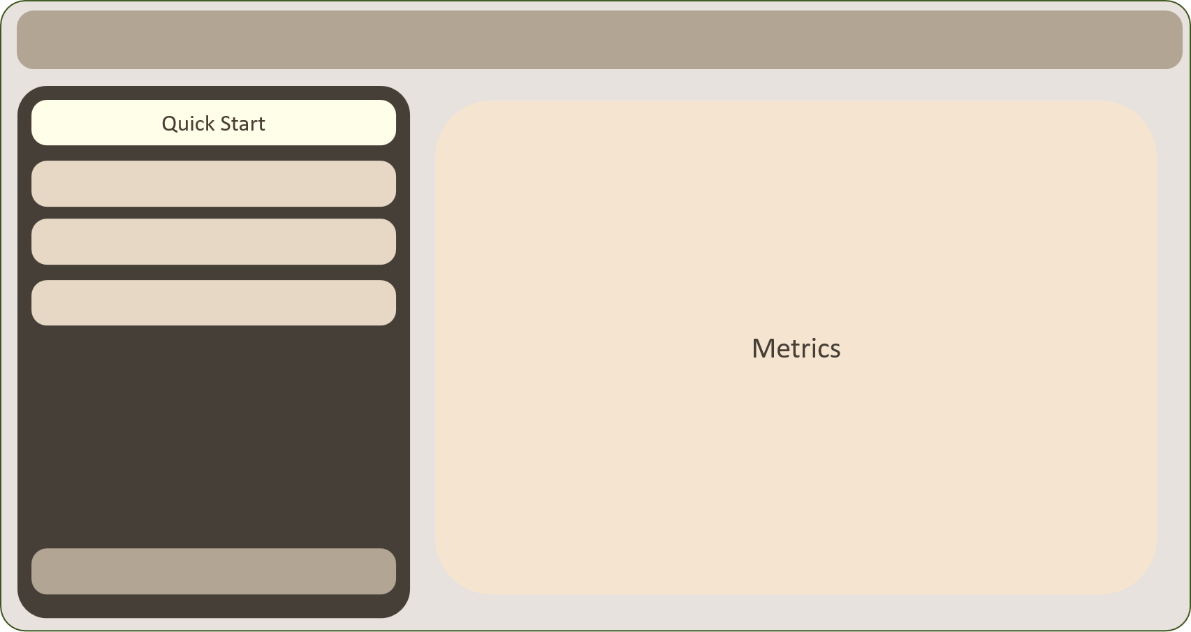
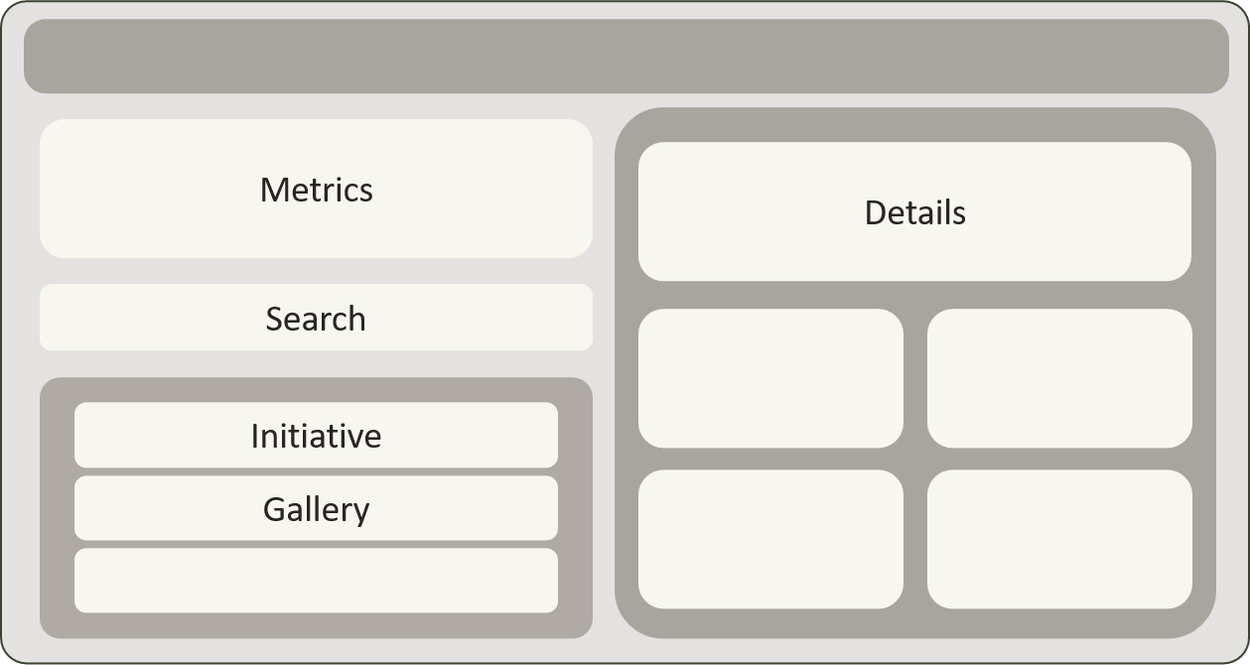
Reform
App Metrics
As a part of a new project to bring about a shift in culture regarding organisational change, a tool which tracks change across business functions needed to be made. This tool is packed with features. From editable columns for excel-like functionality to search functions spanning the entire database (a functionality not embedded in PowerApps), design for the Reform app made me push boundaries in PowerApp functionality.
Records can be edited like an excel sheet in bulk here
Records can be edited in a detailed view like this as well

Slide 12
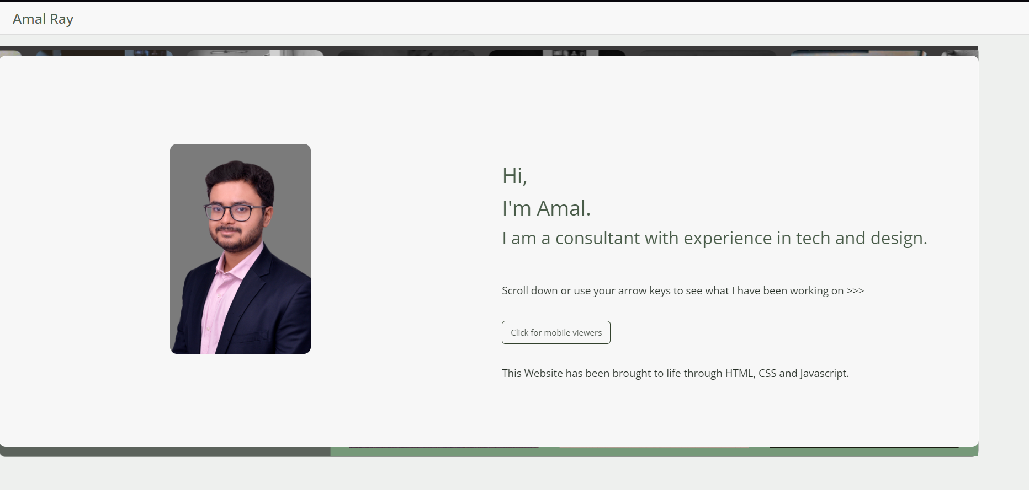
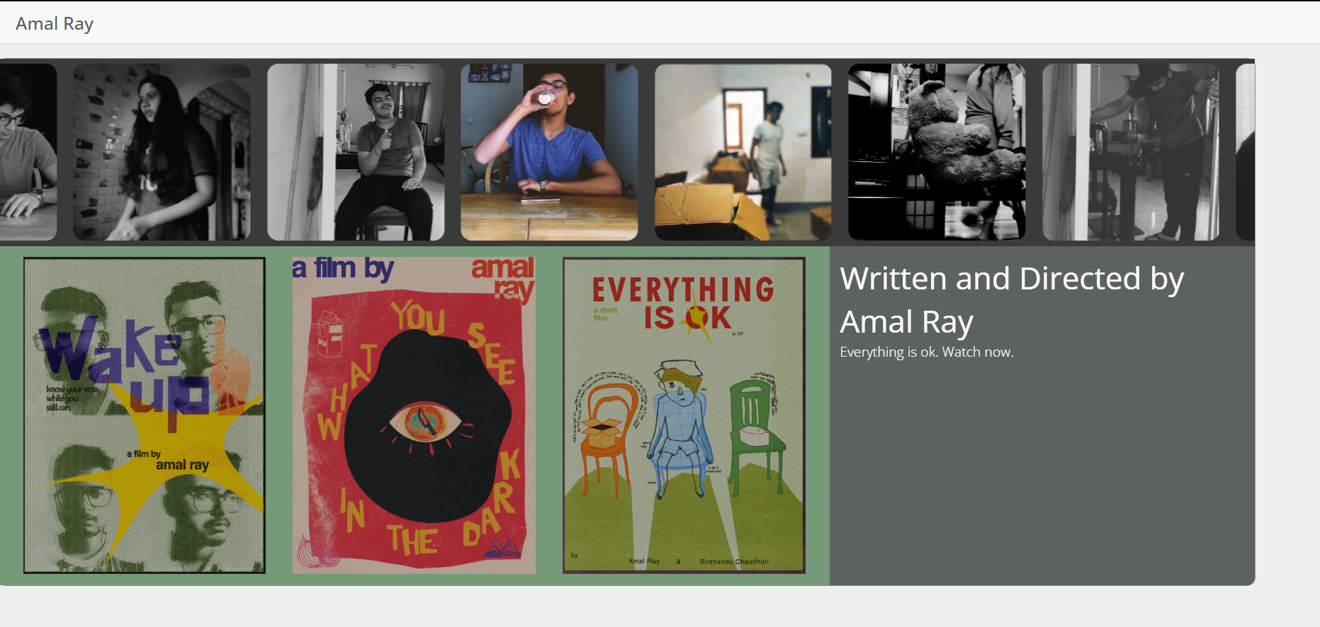
Amal’s Portfolio Website
A strange entry into my portfolio, my website amalray.com was a design innovation and a technical challenge. I wanted to portray my skills as an avid presentation maker at EY – so I set out to emulate it on the web through HTML, CSS and JavaScript. This was a personal project which I took really seriously – I wanted to differentiate my website from others as much as possible. It was a challenge to get this functionality with the limited coding languages, and I am happy with the results.

